Slide 1





People
Processes
Technology
Skills

Slide 2

Agenda
About Revenue
Overview of ICT&L Division
2018 AO ICT Competition
How to Apply

Slide 3
Overview of Revenue
“To serve the Community by fairly and efficiently collecting taxes and duties and implementing import and export controls”.
Approximately 6,000 staff
Deal with almost 3.5 million personal and business taxpayers
Responsible for collecting in the order of €48 billion per annum in taxes and duties for the Exchequer
Offices in all parts of the country

Slide 4
ICT&L Division
290 Revenue ICT Staff
235 External Resources
Accenture, Deloitte, SQS, Version1
Rated the top IT Government Department
Forefront of IT developments
Using all the latest technology

Slide 5
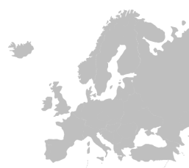
Digital Services Overview
15years+
1st
6th
of 189
Providing Online Services
The Revenue Commissioners Ireland have been pioneers in providing taxation services online for over 15 years
In Europe
Ireland is the easiest country in the EU to pay business taxes
World Bank, IFC, and PwC
Global Ranking
Ireland ranks 6th across 189 global economies for ease of paying tax PwC
94%
72%
98%
VAT
Returns Electronically
Approximately 94% of all business returns are handled electronically
Receipts Collected
72% off all Receipts collected through Revenue’s Digital channels
VAT Receipts Through ROS
98% off all VAT customers file their returns through Revenue Online Services

Slide 6
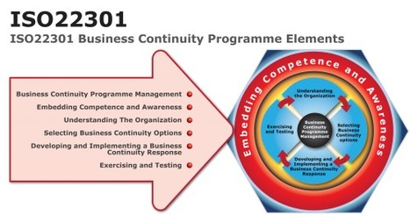
Leading the Way in Ireland
Revenue is the first organisation in Ireland to have achieved the ISO22301 Business Continuity and ISO27001 Security Certifications

Slide 7








Development Technologies
Java
JasperReports
Talend ETL
Spring Framework
AngularJS
Ingres RDBMS
OpenIDM

Slide 8
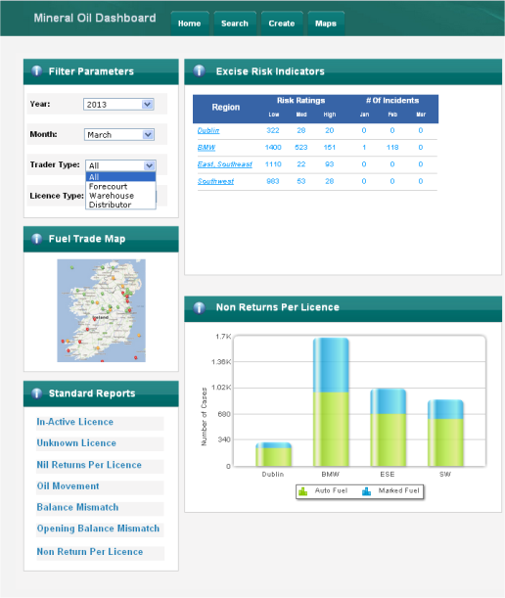
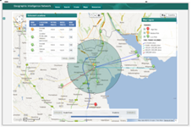
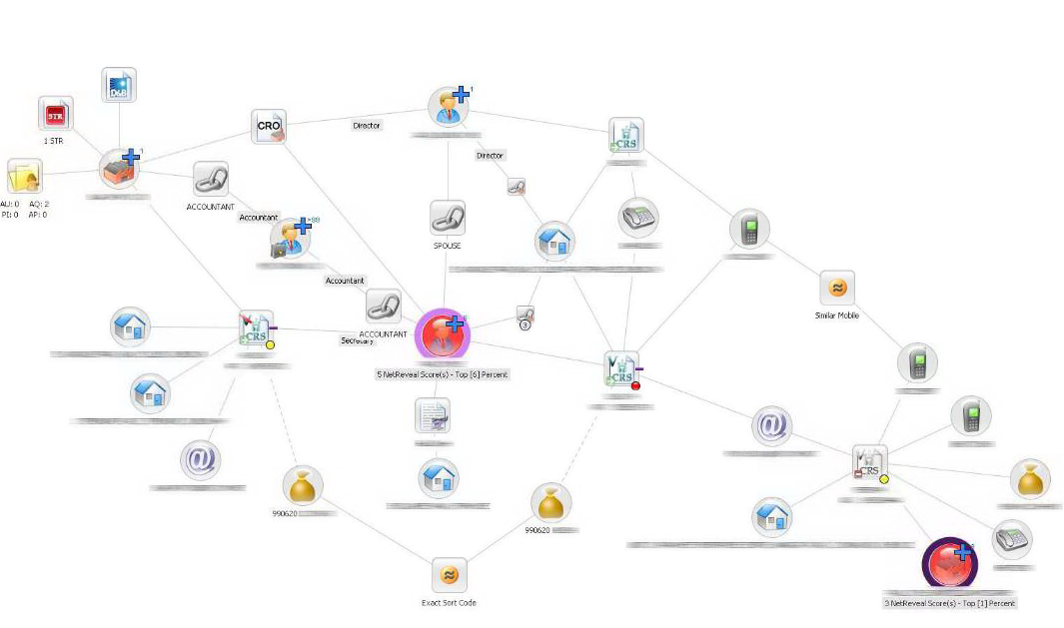
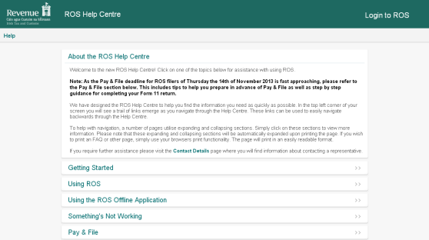


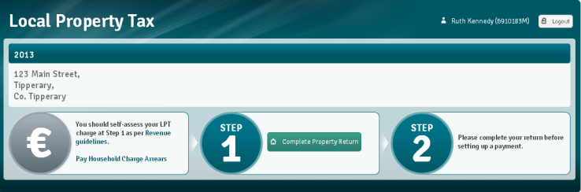

Potential Roles & Projects
Business Intelligence Dashboards
Geographical Information Systems
Analytics and Fraud Detection
Taxation Collection Applications
Mobile Apps
Public Facing Websites

Slide 9
Administration Officer ICT
Development of new applications
Enhancements to existing applications
Agile & Waterfall methodologies used
Interaction with Business users
Governed by Steering committee
On the job mentoring/support
Small/Large teams

Slide 10

Administration Officer ICT
Roles in Dublin and Limerick
Flexible working hours
Continuous Professional Development programme
Wellness programme
30K+ salary
Exciting roles for the successful candidates

Slide 11
How to Apply and the Process
www.revenue.ie/go/144/ or www.publicjobs.ie
Register your application by 1.00 pm on October 11
Information Booklet details entry requirements
Potential selection processes
Eligibility Sift based on Relevant Skills and Knowledge
Competency based interview
Interview - typically
10 minute presentation
35 minutes interview on Application Forms

Slide 12

People
Processes
Thank You!
Technology
Skills

